Slide 1


Last updated July 2021
HORMONAL IUD
INTRODUCTION
Planning
Guide
Photo by Jessica Scranton/FHI 360

Slide 2

Introduction

Slide 3

A global working group was established in 2015 to evaluate the potential to expand access to the hormonal IUD in low-resource settings and meet the method needs and preferences of women.
In 2020, the consortium formalized as the Hormonal IUD Access Group, which regularly convenes to connect work across the supply and demand sides of the market and sustainably increase access to the hormonal IUD.
Several pilot introduction efforts yielded positive results – including high user acceptance and high continuation rates for the method.
This led a consortium of global donors (including USAID, BMGF, FCDO and UNFPA), governments, suppliers and partner organizations to explore concrete opportunities to ensure affordable, secure supply and support introduction of the hormonal IUD beyond pilot settings.

Slide 4
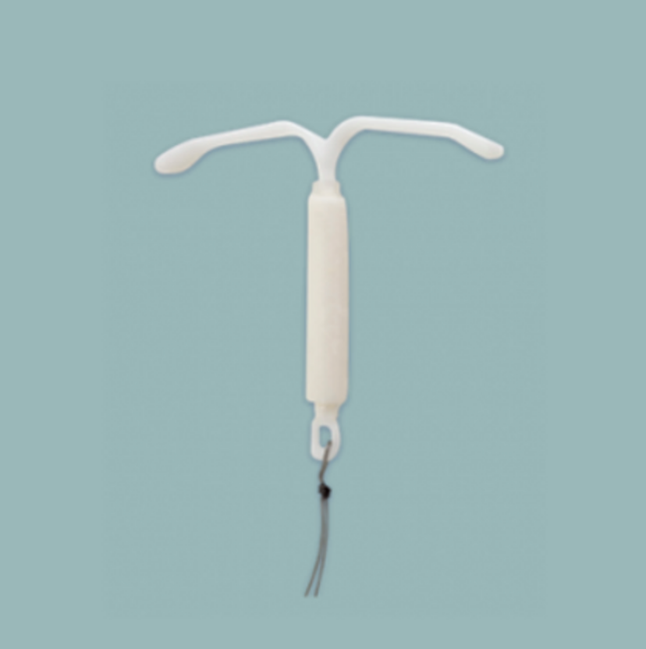
The levonorgestrel-releasing intrauterine device (IUD) – also known as hormonal IUD – is one of the most effective forms of long-acting, reversible contraception. Research has also demonstrated the method also has important non-contraceptive health benefits, including
reduction in menstrual cramps;
less unpredictable bleeding compared to other hormonal methods;
and potential alleviation of anemia for some women (studies are underway).
Additional terms are commonly used to describe the method including levonorgestrel-releasing intrauterine system, hormonal IUS, LNG-IUS, and LNG-IUD. In 2021, the World Health Organization (WHO) adopted “hormonal IUD” as the recommended standardized nomenclature.
Source: See notes
Notes:
Source: https://www.hormonaliud.org//about
Source: https://apps.who.int/iris/bitstream/handle/10665/340378/9789240021730-eng.pdf

Slide 5
The Hormonal IUD Access Group is currently supporting introduction in a group of countries that are ready and willing to incorporate the hormonal IUD into the method mix. Other countries interested in introducing the hormonal IUD are encouraged to engage with the Hormonal IUD Access Group to discuss feasible scope and timing for introduction and begin preparation activities. Please contact: info@hormonaliud.org
The Hormonal IUD Introduction Planning Guide is a resource developed by the Hormonal IUD Access Group to provide guidance for ministries of health (MOHs) and partners to consider when preparing and planning for hormonal IUD introduction.
This resource and other related resources to help facilitate method introduction are available online on the
Hormonal IUD Access Portal in the resource library.

Slide 6
How to use these slides

Slide 7
HOW TO USE THESE SLIDES
This Hormonal IUD Introduction Planning Guide is a resource for countries that are preparing to introduce the hormonal IUD, and can be adapted as needed by country governments and stakeholders. The introduction steps included are all important, but are not necessarily linear, so may not take place in the same sequence in every country. Each section of the guide includes:
a brief description of an important step
in the introduction process,
a checklist for that step,
and questions to consider when
planning that step.
This planning guideline is tailored for hormonal IUD introduction, but most of the elements included here are relevant for any health product introduction effort.
There are supplemental tools and templates to this guide that can be leveraged for hormonal IUD introduction in country, all of which can be located on the Hormonal IUD Access Portal.
As MOHs and partners continue to gather lessons learned from hormonal IUD introductions in countries, this guide and the other tools and templates in the Hormonal IUD Introduction Toolkit will be continuously updated and new resources will be added.
Countries that are preparing to introduce the hormonal IUD are encouraged to check the website regularly.

Slide 8
ABBREVIATIONS
CYP – Couple-Years of Protection
EML – Emergency Medicines List
FP—Family Planning
FCDO – Foreign Commonwealth and Development Office
HCW – Health Care Worker
HMIS – Health Management Information System
HR – Human Resources
IUD – Intrauterine Device
LARC – Long-Acting Reversible Contraceptive
LMIS – Logistics Management Information System
MOH – Ministry of Health
NDRA – National Drug Regulatory Authority
OB-GYN – Obstetrician Gynecologist
SBA – Skilled Birth Attendant
UNFPA – United Nations Populations Fund
USAID – United States Agency for International Development
SRA – Stringent Regulatory Authority
WHO-PQ – World Health Organization Pre-Qualification

Slide 9
Hormonal IUD Introduction Steps

Slide 10
Hormonal IUD Introduction Steps
1
  Establish rationale and objectives for introduction
5
  Update national monitoring systems
2
  Ensure quality-assured product(s) are registered for use and method is included in essential medicines lists and national service delivery guidelines
  Align on demand generation
  strategy and materials
6
3
  Identify health care worker capacity building strategy
7
  Monitor introduction progress
4
  Quantify, procure and integrate commodities into national supply chain processes
8
  Coordinate
Note: These steps are all important, but are not necessarily linear, so do not always take place in the same sequence

Slide 11

1
Establish rationale and objectives for introduction
Considerations
A critical step when planning to introduce any new contraceptive method is to narrow in on the rationale for why it makes sense to introduce the method, where it makes sense to target or begin introduction and to identify key introduction priorities and timelines.
It is important that country introduction plans for the hormonal IUD be phased and focused. A phased approach allows for countries to learn about demand and to build necessary capacity during scale-up.
Learning about country demand from phased introductions also allows for suppliers to plan their production, and coordination can help ensure that global demand for the method does not outpace global supply. For the hormonal IUD, suppliers of quality-assured products are committed to increasing the supply availability of the hormonal IUD for low- and-middle income countries.

Slide 12
1
Establish rationale and objectives for introduction
Considerations
When making a decision to add a new method or product to the method mix, consider the following:
Clinical benefits, e.g. efficacy, side effects, duration, non-contraceptive benefits
Client preferences, e.g. expanded contraceptive choice, opportunity to reach new users, increase satisfaction
Lifestyle benefits, e.g. convenience, discretion
Costs, e.g. costs of introduction and inclusion in method mix, costs to users
Method availability, e.g. number of quality-assured suppliers and product production
Program complexity, e.g. health care worker training needs
Placement e.g. integration into supply chain, private and/or public sector

Slide 13

1
Establish rationale and objectives for introduction
Checklist
Make determination for method introduction based on assessment of benefits and drawbacks and understanding of target market for method
Engage with the Hormonal IUD Access Group on feasibility of scope and potential timelines for introduction
Build consensus on introduction priorities among key stakeholders and document rationale and objectives/timelines

Slide 14
1
Establish rationale and objectives for introduction
1 | Establish rationale and objectives for introduction
WORKSHEET
Question 1.
What is the rationale for introducing the hormonal IUD at this time?
When and where does it make sense to introduce hormonal IUD? Who is the target market?
At what facilities, with what cadres and in what geographies should introduction begin or be targeted?
Answer

Slide 15
1
Establish rationale and objectives for introduction
WORKSHEET
Question 2.
What key introduction objectives do we want to achieve, and in what time frame?
Answer

Slide 16
Ensure quality assured product(s) are registered for use, and method is included in essential medicines lists and standard service delivery guidelines
2
Considerations
In order for products to be introduced in national programs, regulatory requirements must be followed.
UNFPA and USAID require SRA approval or WHO PQ to add products to their catalogs.
While suppliers or distribution partners may take responsibility for submitting dossiers for production registration, processes can often be subject to bottlenecks that cause delays in introduction.
National programs and partners may be able to assist with communication and addressing challenges in the regulatory process.
A waiver may also be an option that can be used to import the product initially.

Slide 17
Ensure quality-assured product(s) are registered for use and method is included in essential medicines lists and national service delivery guidelines
2
Considerations
Hormonal IUD products available on the market (as of April 2021, there are two stringent regulatory authority (SRA)-approved hormonal IUD products):
Product | Supplier | Quality-assured status | Duration of protection/CYP
Avibela | Medicines360 | SRA | Up to 6 years*
Mirena | Bayer | SRA | Up to 8 years*
Eloira | Pregna | Not SRA, Not WHO-PQ; approved in several countries | 5 years
Emily | HLL Lifecare | Not SRA, Not WHO-PQ; approved in several countries | 5 years
Erinna | Meril Life | Not SRA, Not WHO-PQ; approved in India | 5 years
Fiona | Meril Life | Not SRA, Not WHO-PQ approved in India | 5 years
* Labelled duration of use for these products may vary by country registration
[1] Couple-years of protection (CYP) is the estimated protection provided by family planning (FP) services during a one-year period, based upon the volume of all contraceptives sold or distributed free of charge to clients during that period

Slide 18
Ensure quality-assured product(s) are registered for use and method is included in essential medicines lists and national service delivery guidelines
2
Considerations
Essential Medicines List (EML)
National service delivery guidelines
In addition to registering with the appropriate NDRA, program implementers should ensure that the product is included in the country’s Essential Medicine’s List.
National EMLs are often used by governments to guide purchase of priority health commodities.
Including the hormonal IUD on the country’s national EML is critical to ensuring that the hormonal IUD can continue to be procured by the government long-term.
National service delivery guidelines often provide the mandate and framework for pre-service and in-service training curricula and for HR structures.
They also more broadly suggest the necessary equipment, supplies and commodities required for service delivery.
Hormonal IUD clinical guidance should build on and be incorporated into existing national service delivery guidelines for contraceptives, and should include WHO’s medical eligibility criteria guidance on initiation and continuation of 9 common contraceptives, including hormonal IUD.

Slide 19
Ensure quality-assured product(s) are registered for use and method is included in essential medicines lists and national service delivery guidelines
2
Checklist
Confirm supplier(s) have filed dossiers with NDRA to register hormonal IUD product(s)
Monitor registration status and progress with NDRAs
When appropriate, apply for a registration waiver or expedited review process while national registration is pending
Ensure hormonal IUD is included in country’s essential medicines list and national service delivery guidelines, where applicable

Slide 20
Ensure quality-assured product(s) are registered for use and method is included in essential medicines lists and national service delivery guidelines
2
Question 1.
What is the status of registration for hormonal IUD product(s) in your country? If product(s) are not yet registered, can a waiver been pursued?
What are the steps and costs to securing registration? What are the timelines, and who will be responsible?
If product(s) are registered, which product(s)?

Slide 21
Ensure quality-assured product(s) are registered for use and method is included in essential medicines lists and national service delivery guidelines
2
Question 2.
What are the steps to adding the hormonal IUD to the EML? What are the timelines, and who will be responsible?

Slide 22
Ensure quality-assured product(s) are registered for use and method is included in essential medicines lists and national service delivery guidelines
2
Question 3.
What are the steps to add the hormonal IUD to pre-service and in-service national service delivery guidelines?
What are the timelines and who will be responsible?

Slide 23
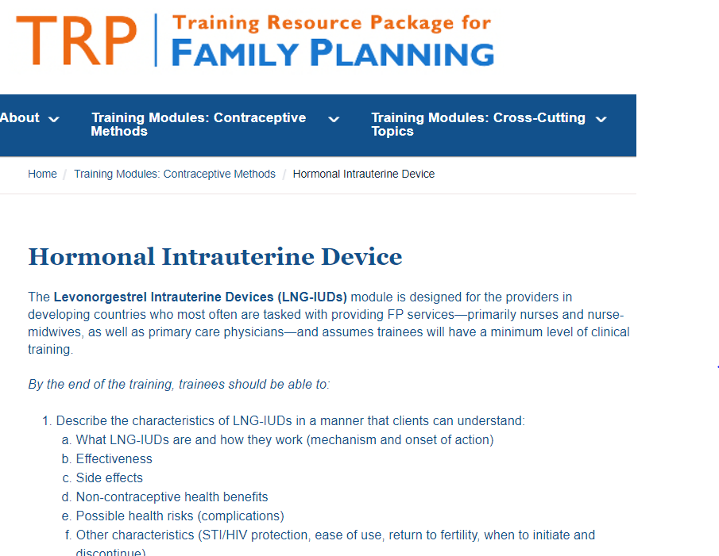
Identify health care worker capacity building models and adopt cascade approach
3
Considerations
Building capacity of health care workers is vital. Personnel that should be oriented to provide high-quality counselling, insertion and removal of the hormonal IUD include physicians, midwives, nurses, and/or skilled birth attendants. Community health workers and/or digital information portals can also be engaged to support awareness generation and demand creation. Supply chain managers should also be engaged to support logistics.
Training modules for health care workers should be high-quality, cost-efficient and fit-to-purpose. These modules should build in plans for mentoring, to ensure strong counseling and service delivery.
The Training Resource Package (TRP) for Family Planning has up-to-date training curricula on FP, including a training module on the hormonal IUD
Existing FP health care providers who are skilled and confident in copper IUD insertion and removal will likely require less time to become competent in insertion and removal of hormonal IUD when compared to health care providers who are inexperienced with copper IUD provision.

Slide 24

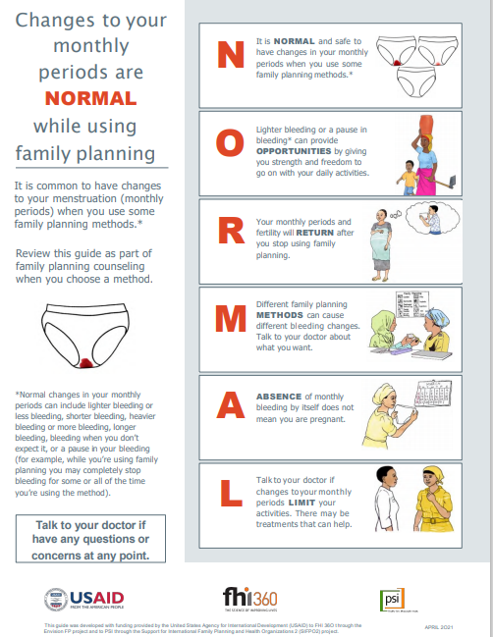
3
Identify health care worker capacity building models and adopt cascade approach
Considerations
NORMAL tool
Counseling about contraceptive-induced menstrual changes is critical for provision of any contraceptive option, and will be a key part of training for the hormonal IUD.
Introduction of hormonal IUD is an opportunity to reinforce the importance of counseling to address any misconceptions on on bleeding changes as it relates to all hormonal methods.
The NORMAL tool is a job aid that contains guidance for health care providers to counsel family planning clients on bleeding changes associated with the use of hormonal contraception and other FP methods. Download the tool here.
For various FP methods, also visit the Training Resource Package (TRP), which along with training curricula, also includes information on common myths and misconceptions about the method, role counseling scenarios, and other counseling checklists and job aids.

Slide 25
3
Identify health care worker capacity building models and adopt cascade approach
Considerations
It takes time and practice to build provider confidence in their insertion skills, and it is also critical to ensure providers believe in the product
To effectively ensure provider skills acquisition, it is critical to build provider competence, a healthy cycle of client demand for services, frequent opportunities for providers to provide services, and provider confidence.
Targeting high volume facilities first can help develop this cycle, and provider champions from these sites can then help in cascading skills to other providers. Training multiple providers per facility and help prevent against loss of skills at facilities due to attrition.
Multi-intervention training approaches are more effective. On-site or on-the-job training can allow for tailor learning and translate to more effective practice. Mass trainings without a plan for sufficient opportunities for practice and frequent provision during and post-training risk:
  Skills atrophy
  Provider biases in service provision and counseling
  Counseling gaps
  Need for re-training
Gaps in client demand, quality counseling, provider skills, comfort, and confidence are factors that have often impacted copper IUD uptake; thus, addressing these barriers with the hormonal IUD is an opportunity to reinvigorate the IUD market.
Provider confidence
Demand for services
Providers learn from guidance, observation, simulated practice and live practice
Provider competence
Confident, skilled clinicians
Source: See notes
Notes:
Effectiveness of strategies to improve health-care provider practices in low-income and middle-income countries: a systematic review. Alexander K Rowe, Samantha Y Rowe, David H Peters, Kathleen A Holloway*, John Chalker, Dennis Ross-Degnan. Lancet Glob Health 2018; 6: e1163–75. Published Online October 8, 2018 http://dx.doi.org/10.1016/ S2214-109X(18)30398-X.

Slide 26
Identify health care worker capacity building models and adopt cascade approach
3
Checklist
Decide appropriate cascade for sequencing capacity building activities with target market in mind (e.g. TOTs, then targeting health care workers with experience inserting/removing copper IUDs, etc.); use the Training Planning and Mapping Tool from this toolkit
Confirm multi-intervention training approach to be used (for both experienced copper IUD providers and new LARC providers)
Update pre-service and in-service training curricula and materials and develop job aides
Develop plan for post-capacity building mentoring activities

Slide 27
Identify health care worker capacity building models and adopt cascade approach
3
Question 1.
How will training and ongoing capacity building for current health care providers be targeted? What are the plans for cascading trainings?
Where will trainings occur and when?

Slide 28
Identify health care worker capacity building models and adopt cascade approach
3
Question 2.
What training approach(es) will be used for training activities?

Slide 29
Identify health care worker capacity building models and adopt cascade approach
3
Question 3.
What steps will be to taken to engage health professional development schools and preservice education institutions in integrating hormonal IUDs into the teaching and clinical skills development of students prior to their graduation?
What training materials will be used/modified?
Who will be responsible for this?

Slide 30
Identify health care worker capacity building models and adopt cascade approach
3
Question 4.
Following capacity-building, how will providers be mentored to ensure continued high-quality service provision?

Slide 31
Quantify, procure and integrate commodities into national supply chain processes
4
Considerations
The quantification process is a critical activity that translates program policies into practical plans for procuring appropriate quantities of hormonal IUD to meet needs for training and provision during introduction.
A phased introduction will support early quantifications - it is difficult to estimate demand for a new method with no historical data. Starting with a targeted, narrow launch allows for time to learn about consumption rates
Quality-assured hormonal IUD products Mirena and Avibela are both available on USAID and UNFPA product catalogs. Lower-middle income countries may be able to receive donated hormonal IUD products via the UNFPA Supplies New & Lesser Used product fund – governments should inquire with the UNFPA country office.
The country should ensure that plans to quantify and procure hormonal IUD are timed so commodities arrive before training and capacity building activities commence (so commodities are available for use during training). To ensure long-term access to hormonal IUD, the method should be integrated into the country’s routine quantification processes.
The method should be integrated into routine storage and transportation processes. However, during introduction, it is important to ensure hormonal IUD only goes to facilities where there are trained providers.
The country should lay out how facilities will receive seed stock, and how they will get replenishments of stock to avoid stock outs.

Slide 32
Quantify, procure and integrate commodities into national supply chain processes
4
Commodities and equipment required for insertion/removal
Considerations
The country should also ensure there is a plan in place to confirm that adequate equipment and supplies are available for provision and removal at all facilities where hormonal IUD will be offered – the plan should include how these supplies will routinely be procured for replacement as needed.
1 | Hormonal IUD in un-damaged, sterile package and inserter
2 | Bivalve speculum, medium and large
3 | Tenaculum
4 | Uterine sound
5 | Sharp scissors, blunt tip
6 | Narrow forceps (e.g. artery or Kelly)
7 | Gloves, single-use disposable
8 | Bowl for antiseptic solution
9 | Antiseptic solution
10 | Sound, uterine, Martin, 32cm
11 | Sterile gauze/cotton balls
12 | Light source to visualize cervix
13 | Drape/cloth to cover table and pelvic area

Slide 33
4
Quantify, procure and integrate commodities into national supply chain processes
Checklist
Leverage existing Technical Working Groups (TWGs) to manage the quantification process
Gather key inputs and ensure data is sufficient and of high quality in order to build a forecast; e.g. using the Quantification of Health Commodities: Contraceptive Companion Guide
Develop a national forecast for hormonal IUD using the appropriate quantification methodology; e.g. using the Forecasting Guide for New and Underused Methods
Develop a supply plan based on the forecasting exercise
Engage with USAID and UNFPA (the hormonal IUD may be available through UNFPA Supplies’ New and Lesser Used product fund) and procure initial volumes of hormonal IUD to arrive before training/capacity building activities commence
Ensure method can be integrated into routine storage and transportation processes
Develop plan for how facilities will get seed stock once they have a trained provider

Slide 34
Quantify, procure and integrate commodities into national supply chain processes
4
Question 1.
What steps must be taken to integrate the hormonal IUD into quantification process? What will the timing for this be?

Slide 35
Quantify, procure and integrate commodities into national supply chain processes
4
Question 2.
What steps will be taken to integrate the hormonal IUD into routine storage and transportation processes?

Slide 36
Quantify, procure and integrate commodities into national supply chain processes
4
Question 3.
What is the plan to ensure facilities with trained providers receive training stock, initial stock and replenishments of hormonal IUD?

Slide 37
Update national monitoring systems
5
Considerations
Most countries have a structured health information system in place across all public sector facilities (and sometimes private sector facilities too) in order to capture the information required for health management decision-making.
Typically, this includes two interrelated systems:
  Health Management Information System (HMIS) which contains health service utilization data and epidemiological information (disease incidence, mortality, morbidity statistics)
  Logistics Management Information System (LMIS) which contains information about the use and availability of commodities. These are health sector wide tools that typically include data that flows from paper registers at facilities, to paper-based monthly aggregate forms to summarize data, to an electronic, national platform such as the District Health Information System (DHIS2).
In order to ensure that information about hormonal IUD service utilization and commodity availability is available at the national level and in a sustainable way, the hormonal IUD should be integrated into both the HMIS and LMIS so it can viewed and analyzed separately from copper IUD.

Slide 38
5
Update national monitoring systems
Considerations
Monitoring hormonal IUD before it is fully integrated in LMIS and HMIS
Planning to integrate hormonal IUD into LMIS and HMIS:
A first goal should be getting hormonal IUD into the electronic LMIS version. Before new paper-based LMIS tools are printed, hormonal IUD can be written in as a new product.
In the time before HMIS can be revised, countries may advise health workers to record both copper IUD and hormonal IUD in the existing “IUD” data element in facility registers and HMIS.
LMIS may be revised more frequently than HMIS since it typically involves more simple tools that may be used at higher sub-national levels (like at the district level or central medical stores rather than each facility).
Most countries will have a data element for IUDs inserted already in HMIS, and when revisions are allowed the existing item should be changed to specify “copper IUD” and a new data element should be added for “hormonal IUD.” The reporting requirements and disaggregation can follow other existing family planning data elements.

Slide 39
5
Update national monitoring systems
Checklist
Identify data that should be tracked long-term through LMIS and HMIS
Develop a plan for integrating hormonal IUD into LMIS and HMIS
Align on near-term solutions for collecting priority data on hormonal IUD before the method is fully integrated into LMIS and HMIS

Slide 40
5
Update national monitoring systems
Question 1.
What data (level/type) for the hormonal IUD should be tracked through the LMIS system long-term? What data (level/type) for the hormonal IUD should be tracked through the HMIS systems long-term?

Slide 41
5
Update national monitoring systems
Question 2.
What steps must be taken to ensure the hormonal IUD is integrated into the country LMIS and HMIS systems? What is the timing for these changes?

Slide 42
5
Update national monitoring systems
Question 3.
How will the country track priority data in the near-term ahead of the hormonal IUD integration into LMIS and HMIS systems?

Slide 43
Align on demand generation strategy and materials
6
Considerations
When a new contraceptive method is added to the method mix, targeted, evidence-based, and compelling communication materials should be created to generate awareness and demand among potential users in the context of voluntarism and contraceptive method choice. The method will be made available to all who are medically eligible, extra efforts can be made to communicate about the method with certain market segments that are more likely to be interested in it.
The objective of generating product-specific messages is to encourage potential clients to engage with health providers who can than appropriately deliver high quality counseling in conversation with them, help them make a choice on what method is best for them and deliver that method.
Communication materials should also be developed to increase providers’ awareness and strengthen their ability to offer high-quality education and comprehensive counseling.
It is important to develop a demand strategy and materials based on a strong understanding of the target market, in conjunction with planned capacity-building activities.

Slide 44

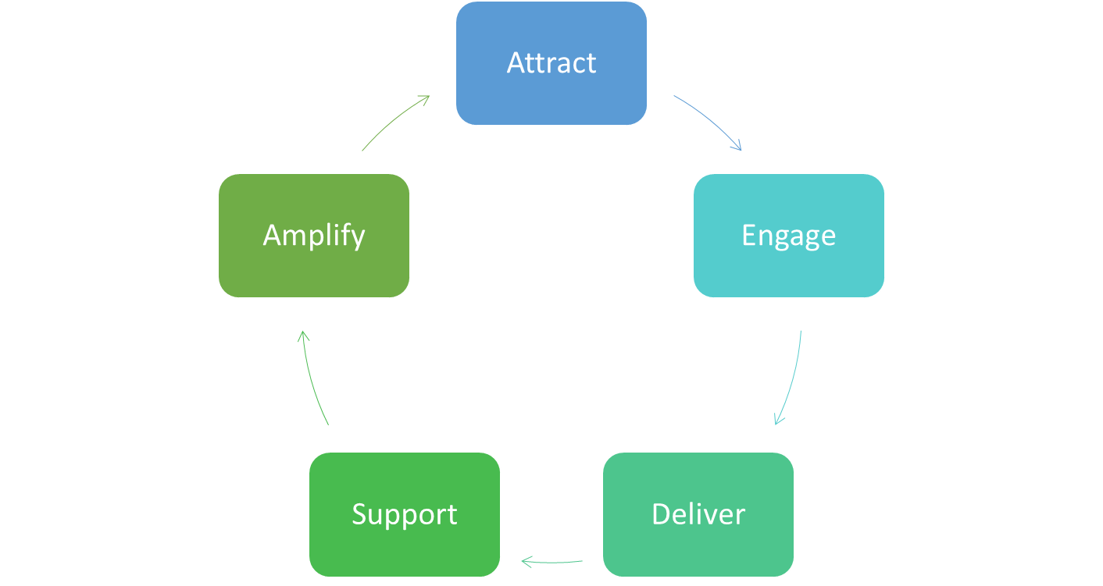
6
Align on demand generation strategy and materials
Product Launch
Considerations
Generate awareness and capture attention with short, compelling messages that intrigue people to want to find out more.
In their consideration, uptake and continuation of contraception, clients go through various stages and require different messaging
It is important to outline:
  What type of key messages will be delivered
  What channels of communication will deliver the messages
  What materials or job aids will be needed
Share stories from satisfied users to create positive hormonal IUD word-of-mouth and help make more women aware.
Provide more information, debunk myths and misconceptions, answer questions, allay fears. Educate on menstrual changes and other possible health benefits and side-effects. Position the hormonal IUD within the full method mix.
Provide proactive follow-up support in the first few months when side-effects and dissatisfaction are likely to be highest
Ensure women are comprehensively counselled on all methods that are suitable for them in a respectful and un-biased way. Ensure the hormonal IUD is available and can be provided in private by a skilled and confident provider

Slide 45
6
Align on demand generation strategy and materials
Considerations
Illustrative guidance for production and activation of demand generation materials
Attract via short emotive message design to capture attention | -Suited to mass media, posters, wall paintings or digital channels – those that are seen or heard at high frequency. It is important to follow country regulations on promotion of medical products. -Emotive and empowering creative should be used - designed to suit the chosen channel of communication
Engage via informative engaging messaging that delves deeper to debunk myths and answer questions | -Suited to group sessions or one-to-one via community outreach or within the facility. -Message should be delivered by a trusted source such as a health worker. -Highly visual materials such as engaging stories or flip charts along with interactive activities.
Deliver comprehensive counseling at the point of service delivery ensuring the woman’s choice is at the center | -This should be communicated via the health provider at the facility -Highly visual job aids should be designed that help the client understand their contraceptive options and how they work -Hormonal IUD information should also be included in any existing basket of choice job aids
Support via interactive, respectful counseling to determine client satisfaction | This could occur via digital health, facility or community-based outreach Guided script and details for referral as needed
Amplify positive, real person client experiences | -This can be developed into any of the Attract and Engage channels - Emotive and empowering creative in the 1st person - designed to suit the chosen channel of communication

Slide 46
6
Align on demand generation strategy and materials
Checklist
Use data to determine the most effective channels of communication that will reach each market segment
Create a plan for how messages will be developed and pre-tested for potential target markets

Slide 47
6
Align on demand generation strategy and materials
Question 1.
What market segments have been identified for this method? How will hormonal IUD-specific messages be developed and tested with each of these market segments?

Slide 48
6
Align on demand generation strategy and materials
Question 2.
How can demand creation for the hormonal IUD be integrated into existing or new activities to generate awareness for family planning?

Slide 49
Monitor introduction progress
7
Evaluate & adjust introduction plan
Considerations
1
Establish costed introduction plan and align on indicators
Monitoring introduction of a new product is key to understanding how the product introduction is progressing and when course-correction is needed. It is best to leverage existing data collection platforms, if possible.
It will be important to learn from each rollout phase and integrate learnings into how the next phase is rolled out – the rollout plan should be iterative.
The process of establishing introduction indicators and setting targets can be a valuable exercise in building consensus around program goals. Implementers need to strike a balance between ensuring sufficient detail to understand product introduction and allowing for available resources to collect, manage and analyze data.
The questions and considerations in the next slide can help ensure the appropriate information is collected to monitor hormonal IUD introduction.
2
Initiate country rollout phase 1
3
Evaluate introduction progress and market health, and identify learnings from phase 1
4
Adjust introduction plans for phase 2

Slide 50
7
Monitor introduction progress
Considerations
These questions and considerations can help ensure the appropriate information is collected to monitor hormonal IUD introduction.
What key indicators should/can be tracked to understand performance in new product introduction?
How should we set targets for performance?
What monitoring processes can be leveraged to track progress against indicators?
Map indicators to introduction plan
Consider introduction process indicators and scale-up indicators
Review available data before setting outcome indicators, and take into account revision to LMIS and HMIS
Indicator match/follow introduction logic (e.g. if we are targeting a specific age group for uptake, we should be able to track uptake within that age group)
Consider data frequency desired (one-time, yearly, quarterly, monthly, etc.)
Refer to pilot data from the same or neighboring countries to guide feasible targets
Consider whether product introduction is targeting specific geographies or facility type and tailor national targets using these assumptions
Consider resources available/needed for collecting, managing and analyzing data.
Consider the persons or organizations that will have ownership of data, who the audiences will be, and how will data be shared with various audiences.

Slide 51
7
Monitor introduction progress
Considerations
Example introduction process milestones | Example introduction scale-up milestones | Example of learning questions
Costed introduction and scale-up plan for hormonal IUD is developed Percent of costed introduction and scale-up plan funded Hormonal IUD is included on EML Hormonal IUD is registered Hormonal IUD is integrated into the national quantification and procurement processes Hormonal IUD is integrated into national logistics management information systems (LMIS) Hormonal IUD is integrated into national health management information systems (HMIS) Hormonal IUD in included in pre-service and in-service FP training guidelines and curricula | Percent of targeted facilities with at least one trained health care worker Number of hormonal IUD units provided to clients Percent of facilities with at least one trained health worker that are active facilities (provided at least one hormonal IUD unit in the last month or quarter) Percent of facilities with at least one trained health worker that are stocked with hormonal IUD (stock on hand at end of month) | What are the profiles of clients who will potentially use this method? Will introduction of the hormonal IUD help reach new FP users? What specific attributes of the method do users find acceptable and unacceptable? What are health care providers' perceptions of and experiences with the hormonal IUD? To what extent is the hormonal IUD cost-effective compared to other LARCs?
For additional guidance, contact: info@hormonaliud.org

Slide 52
7
Monitor introduction progress
Checklist
Align on a process for how introduction progress will be tracked
Decide on process and scale-up milestones and who will be responsible for gathering relevant data
Tailor a country-specific research agenda to identify evaluation questions

Slide 53
7
Monitor introduction progress
Question 1.
What process and scale-up milestones should be tracked?

Slide 54
7
Monitor introduction progress
Question 2.
How will introduction progress be monitored?

Slide 55
7
Monitor introduction progress
Question 2.
What research or evaluation questions are a priority at this time, if any?

Slide 56
Coordinate
8
Considerations
Close coordination before and during introduction is important. In order to ensure that introduction activities are organized and sequenced appropriately, Ministry of Health leaders should engage other country stakeholders such as other government departments (e.g. Ministry of Finance), donors, procurers, private sector and partners early on when developing introduction plans.
It will be helpful to engage with private sector to determine:
  Which hormonal IUD product will be available in public and private sectors, understand pricing, and coordinate on how to prevent leakage
  Determine if/how to coordinate on training, supervision, data collection, product distribution, etc.

Slide 57
8
Coordinate
Considerations
Introduction plans should be costed and available resources (domestic and donor) should be mapped and tracked against the introduction plan by output. Any gaps should be identified and elevated to the Hormonal IUD Access Group. To support costing of the introduction plan, see the Hormonal IUD Introduction Work Plan and Costing Tool.
It is recommended that during introduction, introduction task team meets often (e.g. monthly or quarterly) to monitor progress, identify data needs, discuss policy questions, share lessons learned and identify bottlenecks. To quantify the number of trainers, and health care providers needed and to track planned and completed training, see the Hormonal IUD Training Planning and Mapping Tool.
At the global level, all countries introducing or preparing to introduce hormonal IUD are encouraged to participate in the Hormonal IUD Access Group, join meetings and webinars, and leverage resources from the https://www.hormonaliud.org/.
Please contact for more details: info@hormonaliud.org

Slide 58
8
Coordinate
Checklist
Task team meets to develop introduction plans and establish cadence for meeting regularly
Develop costed introduction plan, map resources to introduction plan, identify gaps and elevate

Slide 59
8
Coordinate
Question 1.
What relevant stakeholders should be engaged for introduction of hormonal IUD? What is the appropriate mechanism for this coordination? How often will stakeholders meet?

Slide 60
8
Coordinate
Question 2.
Who will be responsible for monitoring progress regarding the steps outlined in this plan?

Slide 61
For more information or to seek additional support with introduction or scale-up,
contact info@hormonaliud.org

Slide 62
Annex

Slide 63
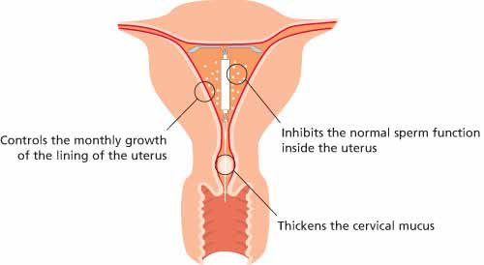
Overview of the Method
How the hormonal IUD works
The hormonal intrauterine device (IUD) is a safe, highly effective contraceptive method suitable for most women.
What is the hormonal IUD?
Long-acting, reversible form of contraception that is highly effective
Small piece of flexible plastic shaped like a T*
Contains the progestin levonorgestrel
Known as the levonorgestrel intrauterine device (LNG-IUD), hormonal IUD, or levonorgestrel intrauterine system (LNG-IUS)
Releases a small amount of progestin into a woman’s body over several years
Requires nonsurgical placement of the device into the uterus by a trained health professional
Hormonal IUD structure
*All SRA-approved hormonal IUD products are T-shaped, but some products are shaped differently
*Device sizes vary

Slide 64
Effectiveness &
continuation rates
The percentage of women who experienced an unintended pregnancy within the first year of typical use
Method | Typical Use | Perfect Use | Continuation Rate at One Year
No method | 85% | 85% | NA
Spermicides | 28% | 18% | 42%
Condom | 18-21% | 2-5% | 41-43%
Diaphragm | 12% | 6% | 57%
OCPs | 9% | 0.3% | 67%
Patch | 9% | 0.3% | 67%
Ring | 9% | 0.3% | 67%
DMPA | 6% | 0.2% | 56%
Copper IUD | 0.8% | 0.6% | 78%
Hormonal IUD | 0.2% | 0.2% | 80%
Implants | 0.05% | 0.05% | 84%
Female Sterilization | 0.5% | 0.5% | 100%
Male Sterilization | 0.15% | 0.10% | 100%
The hormonal IUD is one of the most effective methods of contraception available and offers long-acting protection
The hormonal IUD has high continuation rates among users
Effectiveness
12-month continuation data | Hormonal IUD | Copper IUD | Implant
Nigeria | n=266 | n=274 | n=295
 | 86.8% (82.1-90.4) | 86.9% (82.1-90.4) | 85.0% (80.2-88.7)
Zambia | n=140 | n=149 | n=78
 | 94.7% (89.2-97.4) | 89.1% (82.3-93.4) | 83.1% (72.2-90.1)
Source: Trussell J. Contraceptive failure in the United States. Contraception. 2011;83(5):397–404. doi:10.1016/j.contraception.2011.01.021
Source: FHI 360, PSI and Society for Family Health. LEAP Initiative. Hormonal IUD Updates: New Insights and Steps Toward Scale. Day 1 of Global Technical Consultation. Washington D.C.: U.S. Agency for International Development; 2020. Available from: https://www.hormonaliud.org/ourlibrary/User/resource/Hormonal-IUD-Updates%3A-June-2020-Technical-Consultation-%E2%80%93-Day-1

Slide 65
Most women can use the hormonal IUD - there are some contraindications
Eligibility criteria
Approved for use in women who:
Contraindications:
Have or have not had children
Are or are not married
Are of any age, including adolescents and women over 40
Have just had an abortion or miscarriage (if no evidence of infection)
Have just had a baby (<48 hours or > 4 weeks postpartum)*
Are breastfeeding
Have had pelvic inflammatory disease
Have vaginal infections
Have anemia
Have HIV clinical disease that is mild or with no symptoms, whether or not they are on ART
Pregnancy
Between 48 hours and 4 weeks postpartum
Blood clot in legs or lung
Liver disease or liver cancer
Breast cancer
Unexplained vaginal bleeding
Severe or advanced HIV infection
Genital cancer, pelvic tuberculosis or gestational trophoblastic disease
Current gonorrhea or chlamydia infection
Note: Manufacturers’ labels for hormonal IUD products do not currently include an indication for immediate postpartum insertions. However, the World Health Organization’s Medical Eligibility Criteria for Contraceptive Use categorizes immediate postpartum insertion [<48 hours] of the hormonal IUS as a category 1 [no restrictions] in non-breastfeeding women and as a category 2 [benefits outweigh the risks] in breastfeeding women.

Slide 66
Additional Information

Slide 67
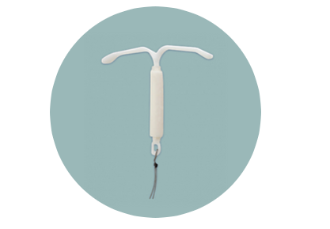

For more information visit the Hormonal IUD Access Portal
The Hormonal IUD
Access Portal
www.hormonaliud.org
Acknowledgements
This resource was developed by CHAI and FHI 360 with funding from the Foreign, Commonwealth & Development Office (FCDO), the U.S. Agency for International Development (USAID), and the Bill & Melinda Gates Foundation. We thank the partners who contributed to the development and review of this tool, including UNFPA, Jhipego, MSI, Pathfinder, PSI, WCG and others.
Contact us
For more information about efforts to introduce and scale-up the hormonal IUD, contact: info@hormonaliud.org

